Slide 1
TENTATIVE PARCEL MAP CASE NUMBER WTPM20-0001
(MHC 70)
Washoe County Parcel Map Review Committee
April 9, 2020

Slide 2
Request
Tentative parcel map to divide one parcel of approximately 35.73 acres into two parcels of approximately 25.73 acres and approximately 10.0 acres.

Slide 3
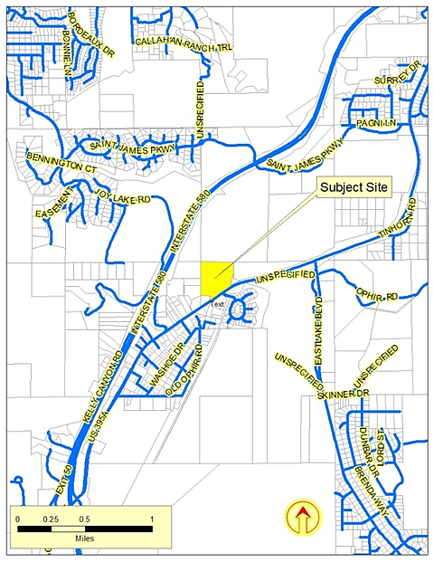

Slide 4
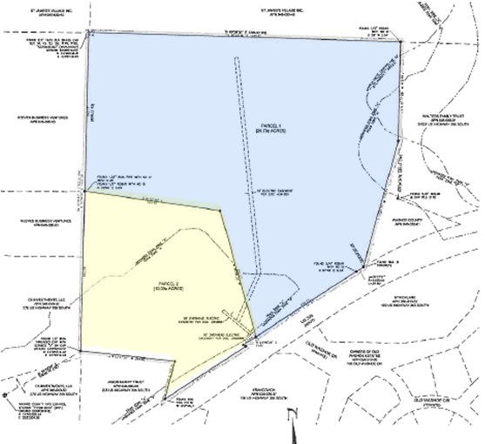

Slide 5
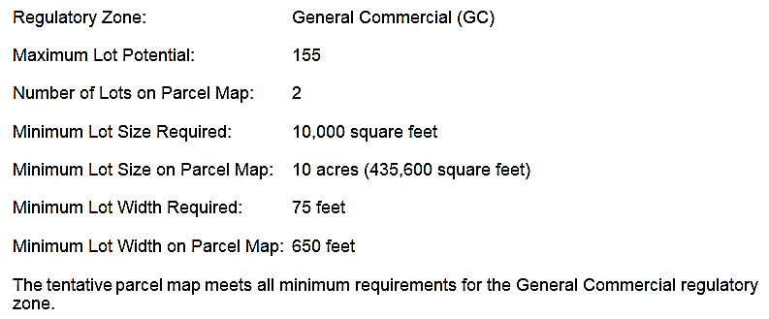
Overview

Slide 6
Overview
Development Suitability Constraints: The South Valleys Area Plan Development Suitability Map, a part of the South Valleys Area Plan, identifies the subject parcel as having slopes greater than 15%, slopes greater than 30% and a ridgeline to be protected.

Slide 7
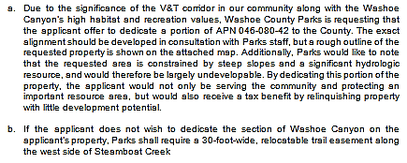
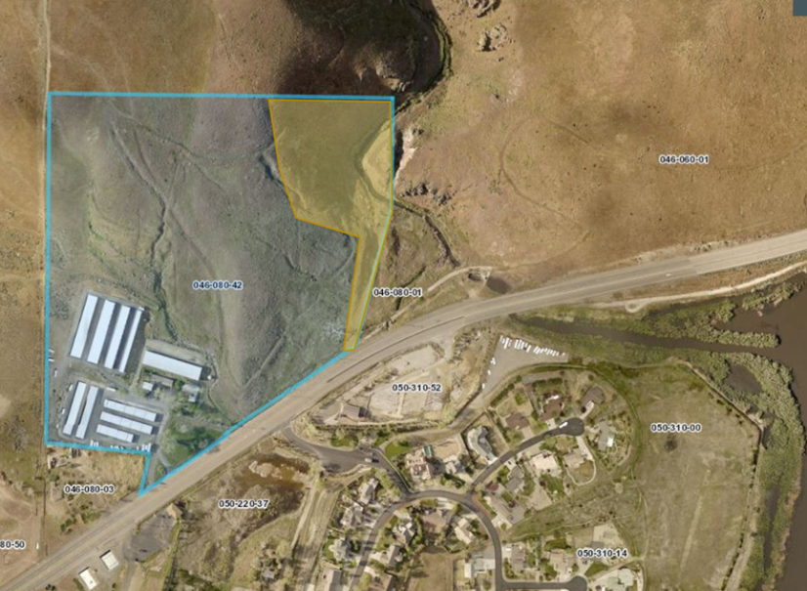
Conditions of Approval

Slide 8
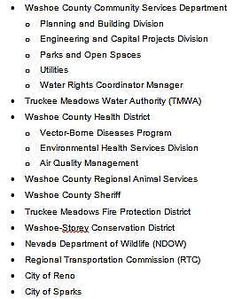
Reviewing Agencies

Slide 9
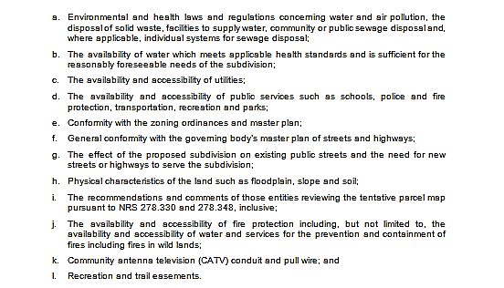
Tentative Parcel Map Findings

Slide 10
Recommendation
After a thorough analysis and review, Parcel Map Case Number WTPM20-0001 is being recommended for approval with conditions.

Slide 11
Possible Motions
I move that, after giving reasoned consideration to the information contained within the staff report and the information received during the public meeting, that the Washoe County Parcel Map Review Committee approve Parcel Map Case Number WTPM20-0001 for MHC 70, LLC, subject to the conditions of approval included as Exhibit A with the staff report, and make the determination that the following criteria is or will be adequately provided for pursuant to Washoe County Code, Section 110.606.30.

